Slide 1
WELCOME
SK SERI BINTANG SELATAN

Slide 2
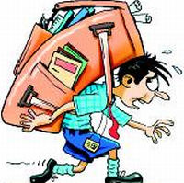
SK Seri Bintang Selatan, KL
Effects of Heavy Bags on Children
A Presentation to Parents
Ouch!! My back hurts, Mom !!
video

Slide 3
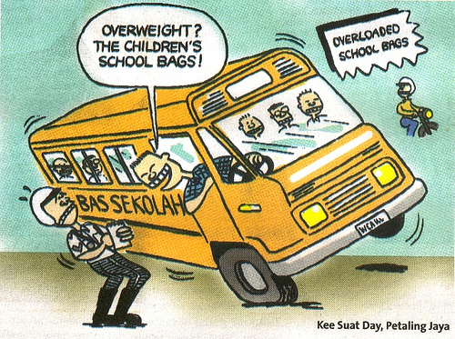
School children are burdened to carry a variety of heavy objects to school eg. large text books, note books, sports kits, heavy stationary, water bottle and Tiffin box.
Sometimes the weight carried on their back is 30% to 40% of their own weight. This leads to various problems for the children.

Slide 4
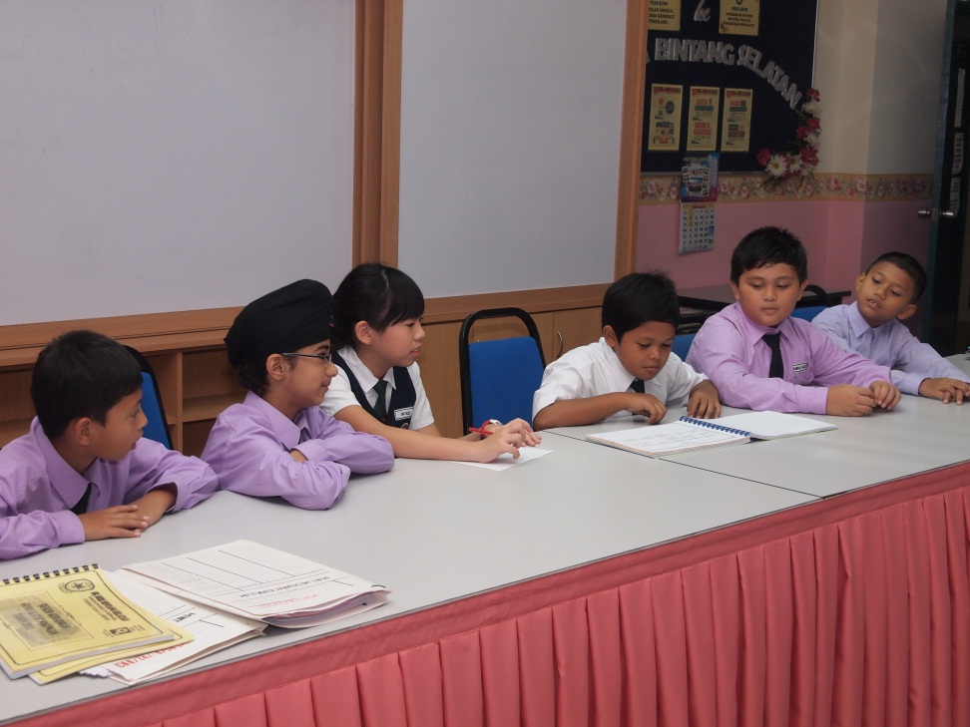
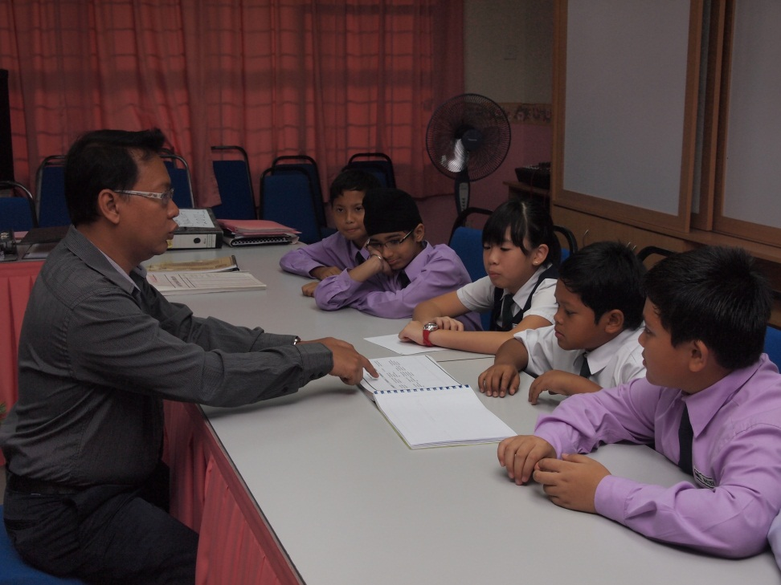
In view of this problem, we the SKSBS’ CyberFair Project Team 1 has taken up an initiative to address and resolve this problem
The Team…

Slide 5
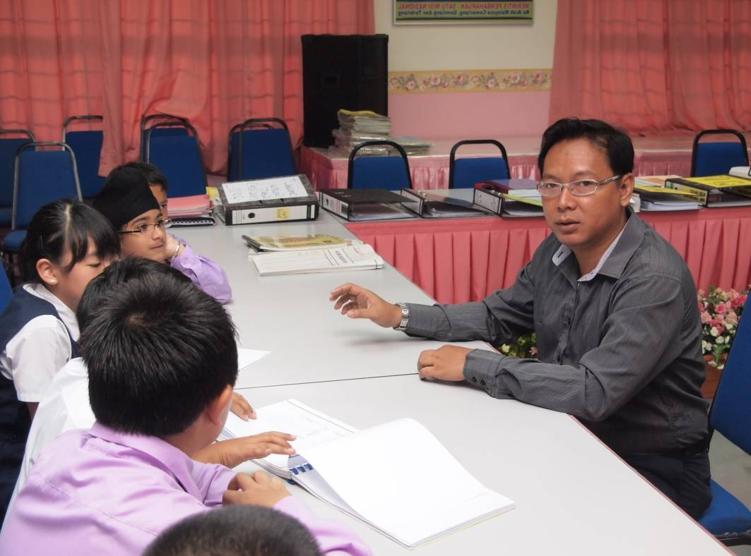
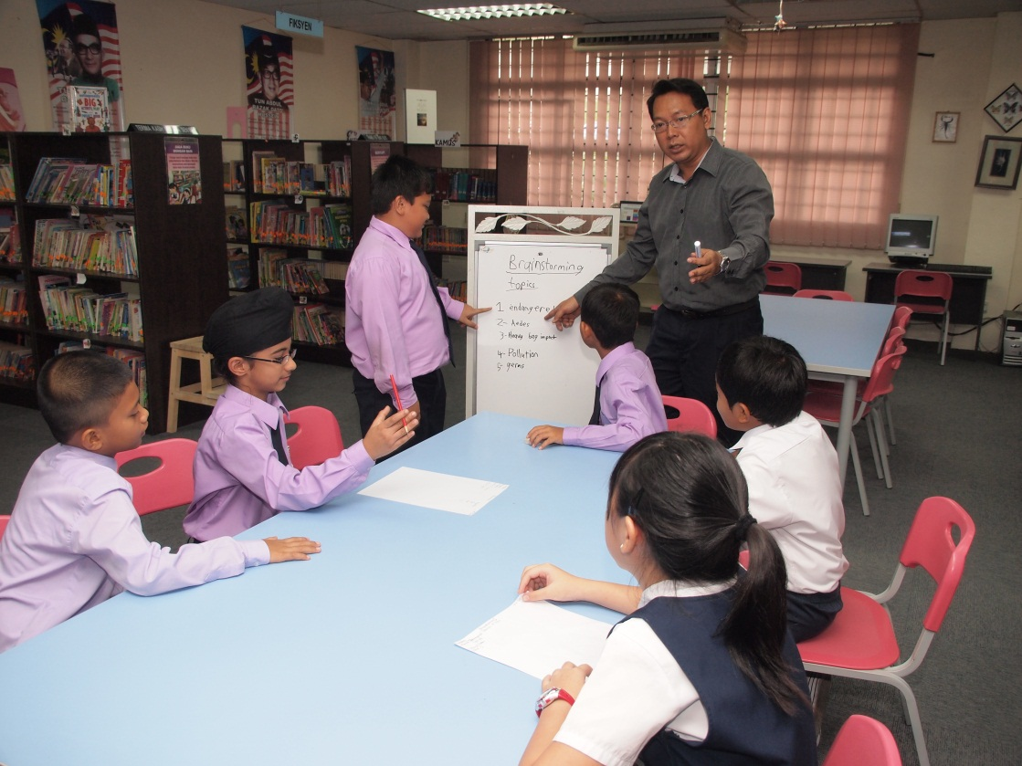
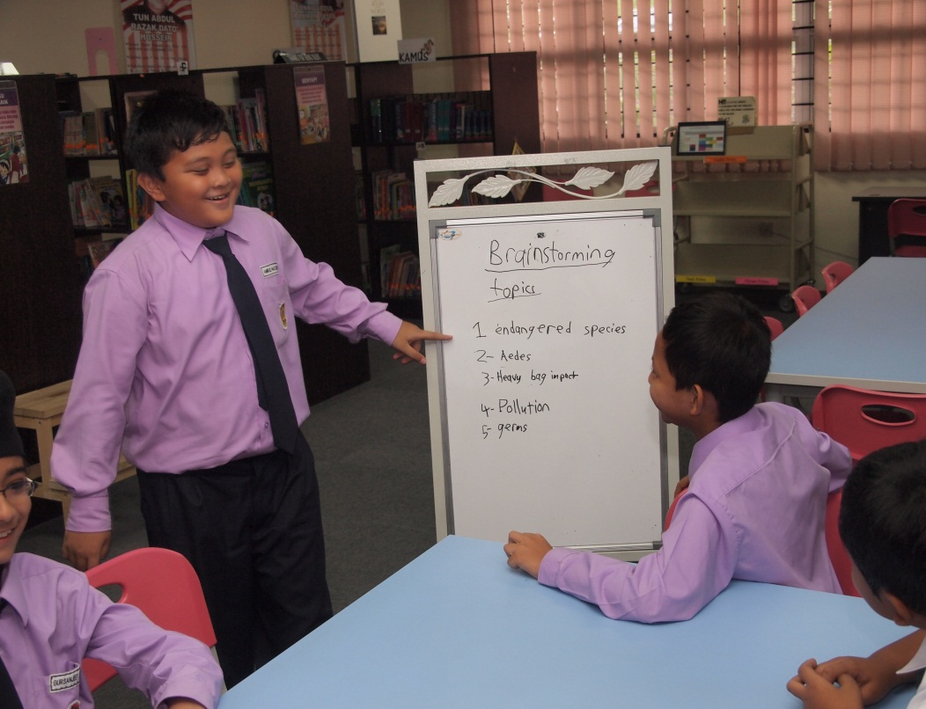
The Team….
In Action

Slide 6
We present here the following;
Views of our school teachers
Effects on students’ health
Facts and findings
Recommended solutions

Slide 7
Views of our school teachers
video

Slide 8
Effects on students’ health
Lets view this the live demo…
Now lets view the same in animated form to see how does the damage takes place
Clips\bone1.swf
This also causes inconvenience in moving around and accidents.

Slide 9
Facts and findings
The weight of the bag should not exceed 10% to 15% of the child’s weight.
International Recommended Backpack Weight
Student's Weight | Maximum Bag Weight
(KG) | (KG)
25 | 3
25-35 | 4.5
35-45 | 7
45-55 | 8
55-65 | 9
No one should carry more than 10kg

Slide 10
Initiatives by the School
1) Assisting smaller kids in lifting their heavy bags when climbing the staircase
Clips\2video_0003.wmv

Slide 11
Initiatives by the School
2) Providing Lockers for all students

Slide 12
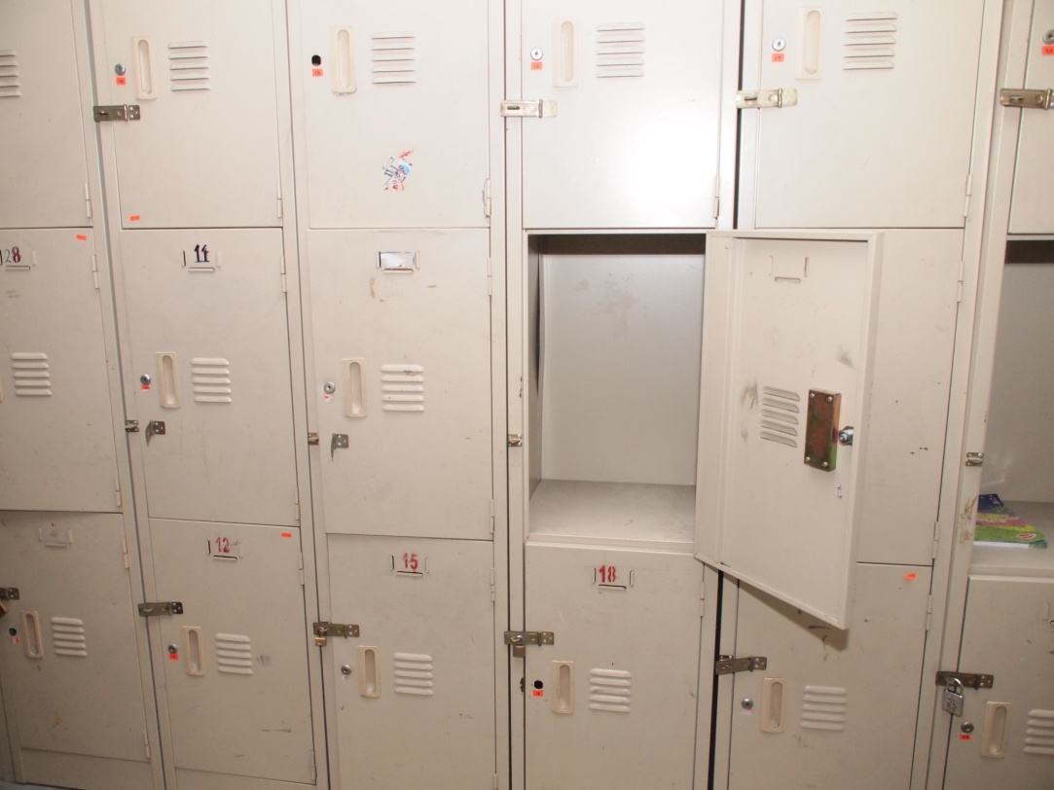
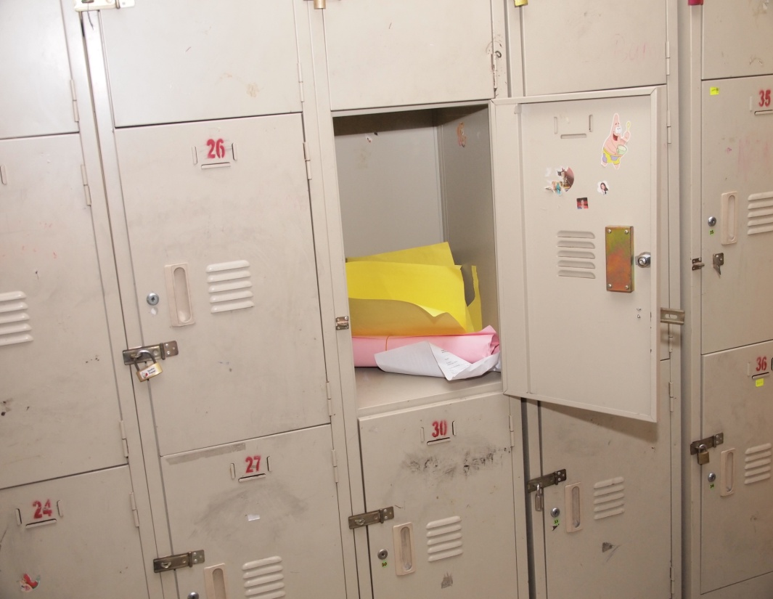
Initiatives by the School
However, the lockers are not fully utilised

Slide 13
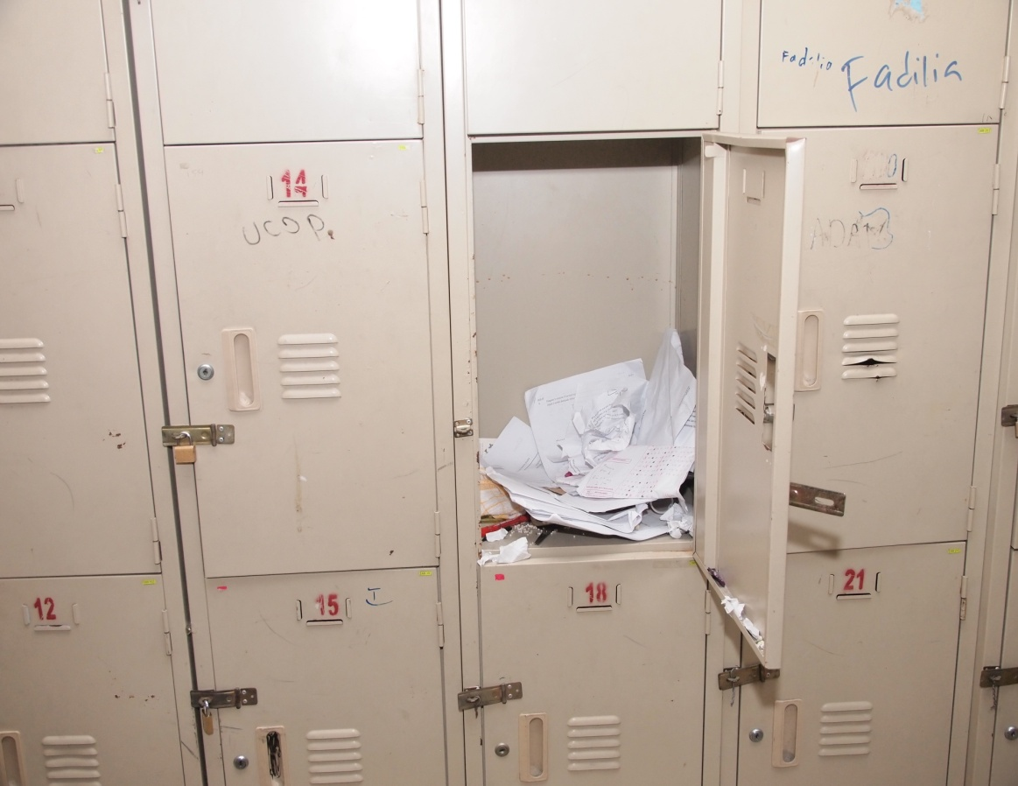
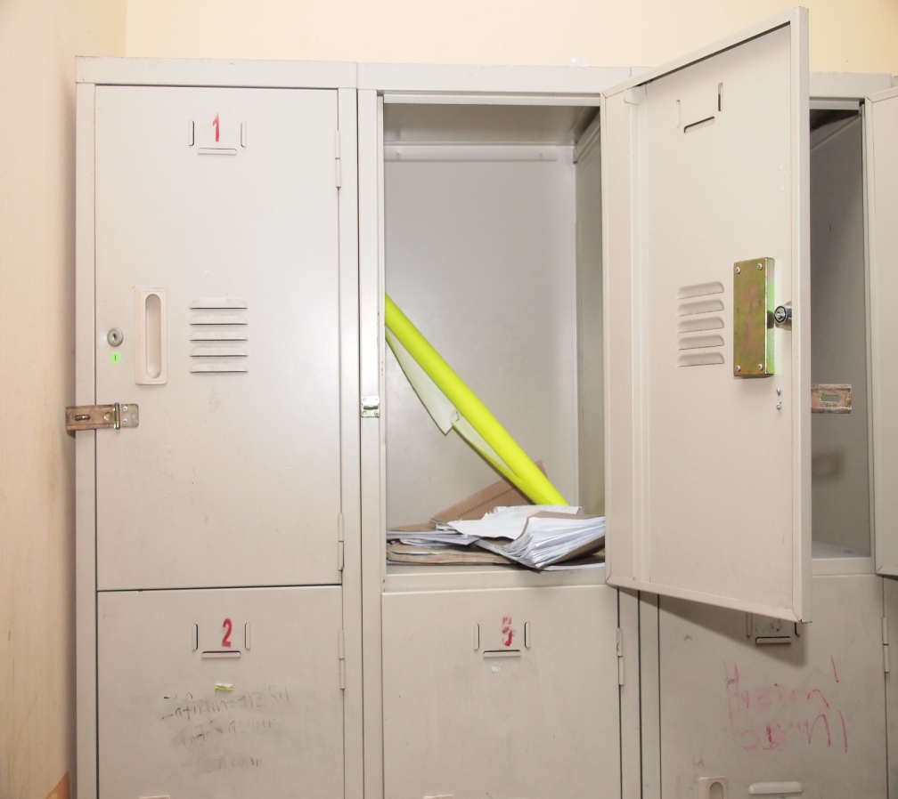
Initiatives by the School
continue…
Lockers are not fully utilised. Based on our findings, there are not many schools which provides such privileges

Slide 14
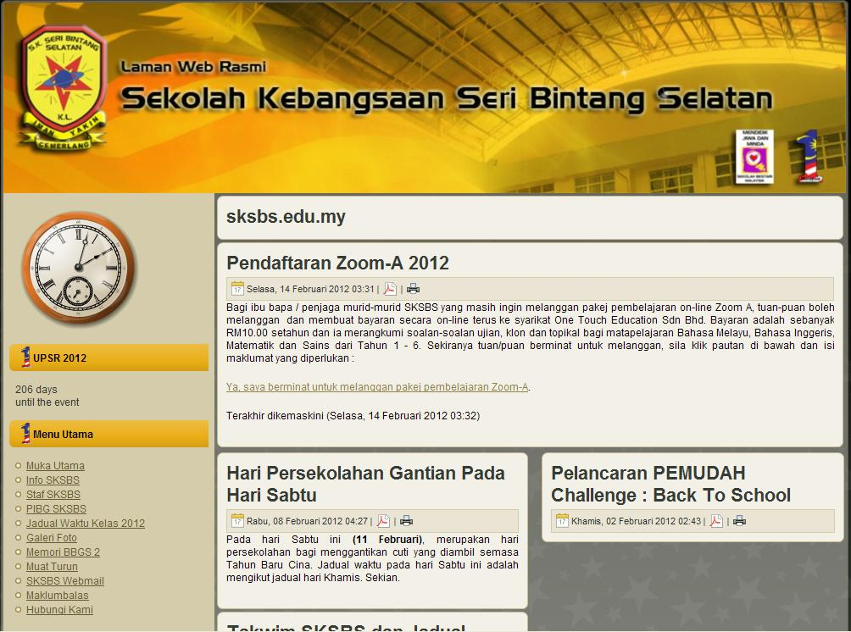
Initiatives by the School
3) The School puts up the Time-table on its website every year, so that parents and students can view it anytime

Slide 15
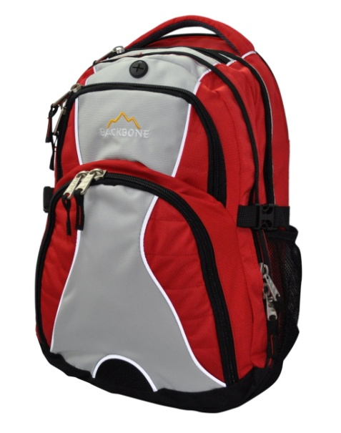
Suggested solutions
Ensure your child;
Follows the time table
Carry the required items only
Use the school lockers frequently
Wear both straps of the bag and position the bag correctly
Do not purchase bags made of heavy materials, eg. leather
Parents to regularly monitor the weight of the children’s bag

Slide 16
Thank You
SK Seri Bintang Selatan students shall be putting up this study in a detailed manner for the upcoming International Competition known as CyberFair organised by Global School Net.
We would appreciate parents’
Constructive comments, to ensure
SKSBS emerges the overall
Champions in this International
competition.

Slide 17
Special thanks to
En Azhari bin Hj Omar
Pn Lim Choo Siem
En Halim
En Rashdan
All Teachers and Parents

